Slide 1



Noida Institute of Engineering and Technology, Greater Noida
Understanding Human Desirability
Unit: V
Subject Name: Design Thinking II
Ms. Barkha Bhardwaj
Assistant Professor (CSE-AI)
NIET, Gr. Noida
Course Details: B Tech 5th Sem

Slide 2
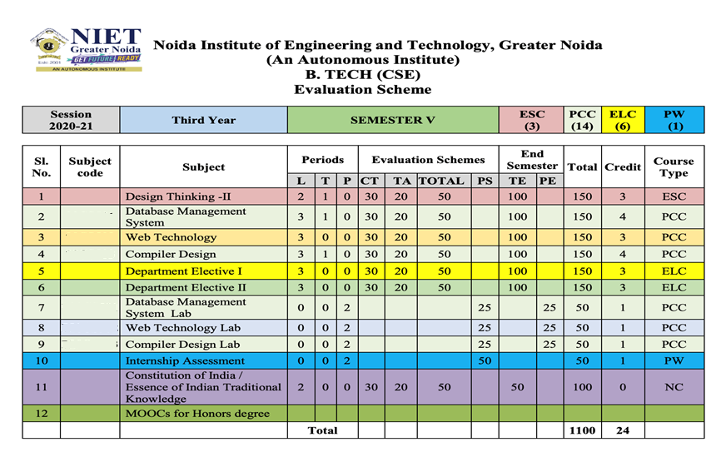
Evaluation Scheme

Slide 3
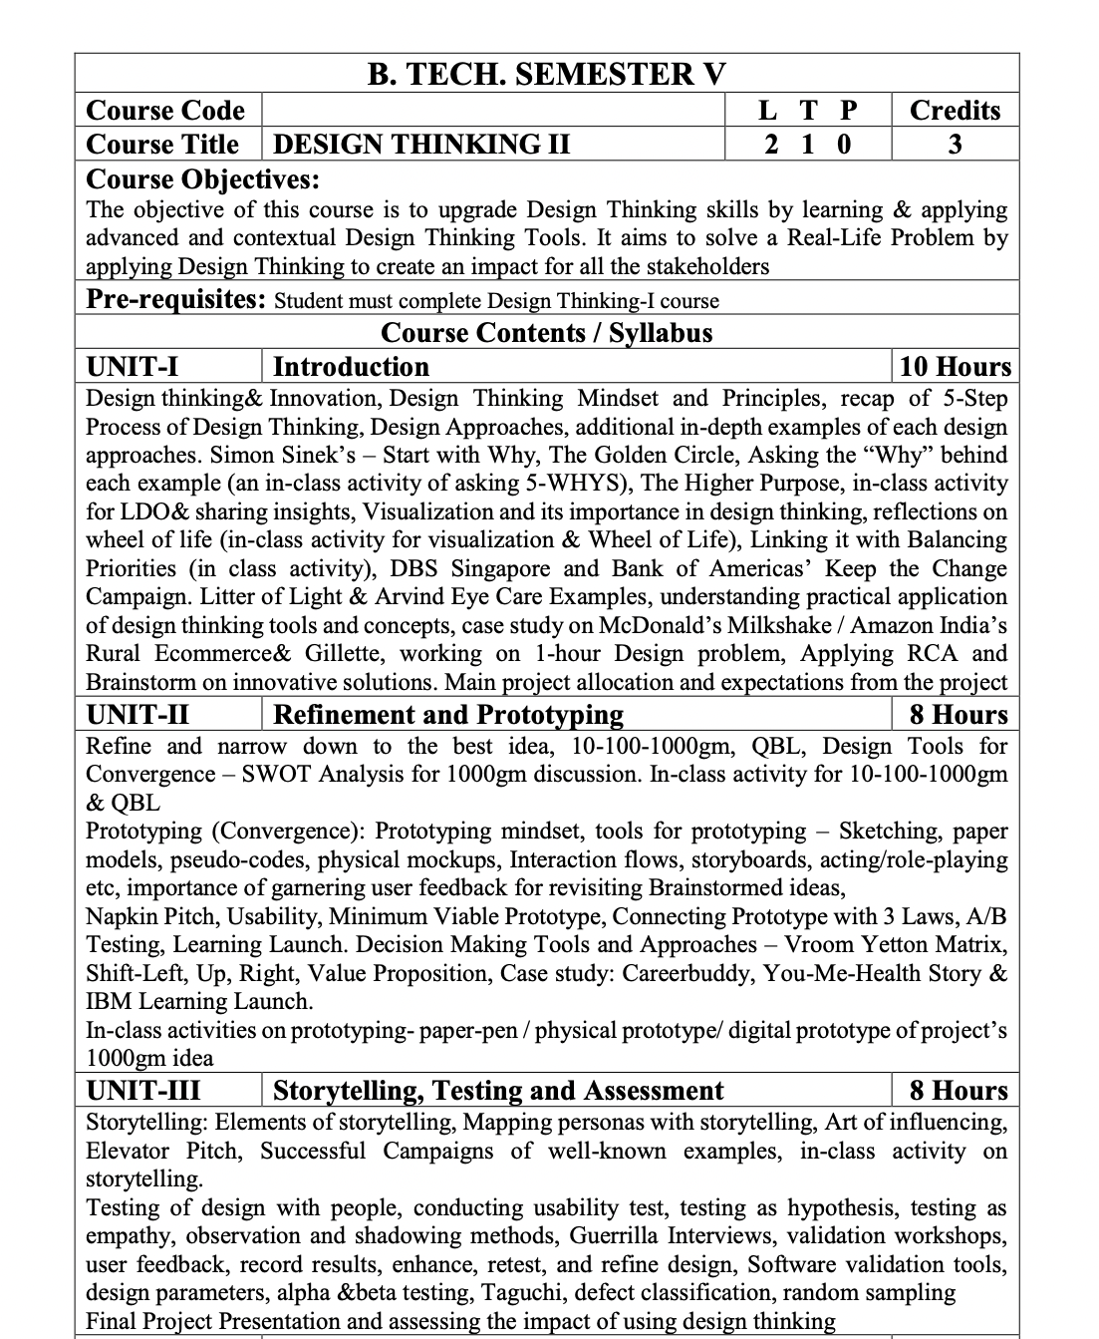
Syllabus

Slide 4
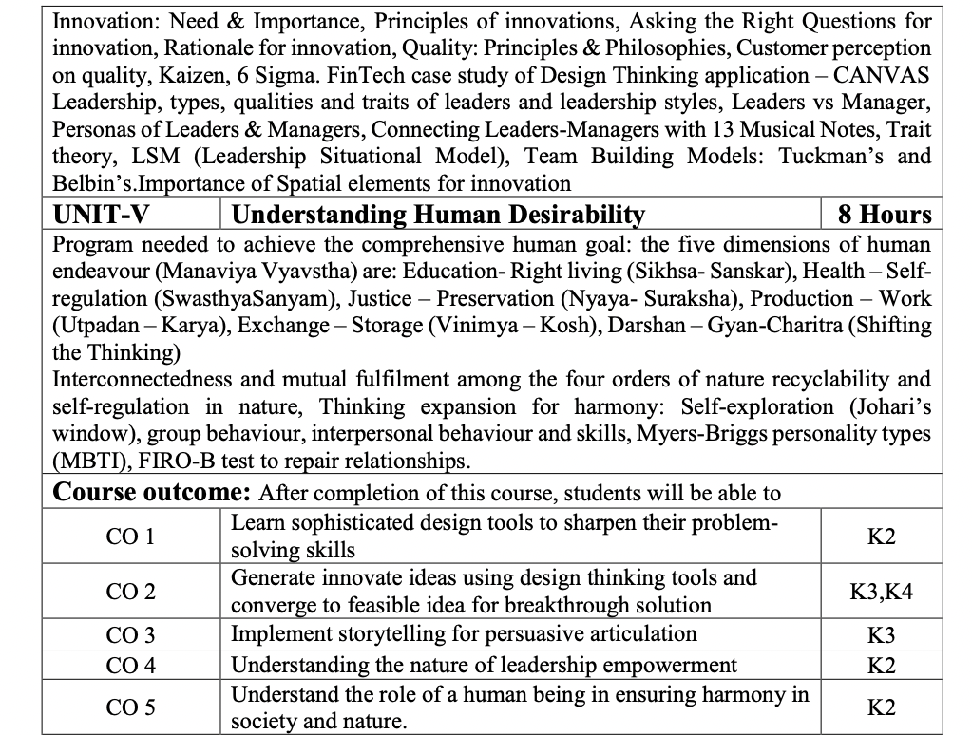
Syllabus

Slide 5

Content
Achieve the comprehensive human goal: the five dimensions of human endeavour(Manaviya Vyavstha) are:
Education- Right living (Sikhsa- Sanskar),
Health – Self-regulation (SwasthyaSanyam),
Justice – Preservation (Nyaya- Suraksha),
Production – Work ( Utpadan – Karya),
Exchange – Storage (Vinimya – Kosh),
Darshan-Gyan-Charitra (Shifting the Thinking)
Interconnectedness and mutual fulfilment among the four orders of nature recyclability and self-regulation in nature
Thinking expansion for harmony:
Self-exploration (Johari’s window),
group behaviour,
interpersonal behaviour and skills,
Myers-Briggs personality types (MBTI),
FIRO-B test to repair relationships.

Slide 6
Course Objective
The objective of this course is to upgrade Design Thinking skills by learning & applying advanced and contextual Design Thinking Tools.
It aims to solve a Real-Life Problem by applying Design Thinking to create an impact for all the stakeholders

Slide 7
Course Outcome
After completion of this course, students will be able to-
CO1: Learn sophisticated design tools to sharpen their problem- solving skills.
CO2: Generate innovate ideas using design thinking tools and converge to feasible idea for breakthrough solution.
CO3: Implement storytelling for persuasive articulation
CO4: Understanding the nature of leadership empowerment
CO5: Understand the role of a human being in ensuring harmony in society and nature.

Slide 8
Program Outcomes (POs)
Engineering Graduates will be able to:
PO1 : Engineering Knowledge
PO2 : Problem Analysis
PO3 : Design/Development of solutions
PO4 : Conduct Investigations of complex problems
PO5 : Modern tool usage
PO6 : The engineer and society

Slide 9
Program Outcomes (POs) cont…
Engineering Graduates will be able to:
PO7 : Environment and sustainability
PO8 : Ethics
PO9 : Individual and teamwork
PO10 : Communication
PO11 : Project management and finance
PO12 : Life-long learning

Slide 10

COs - POs Mapping
CO.K | PO1 | PO2 | PO3 | PO4 | PO5 | PO6 | PO7 | PO8 | PO9 | PO10 | PO11 | PO12
CO1 | 2 | 2 | 2 | 3 | 3 | 2 | 2 | 2 | 3 | 2 | 3 | 3
CO2 | 3 | 2 | 3 | 2 | 3 | 2 | 2 | 3 | 2 | 2 | 2 | 3
CO3 | 3 | 2 | 3 | 2 | 3 | 2 | 2 | 3 | 2 | 2 | 2 | 3
CO4 | 3 | 2 | 3 | 2 | 3 | 2 | 2 | 3 | 2 | 2 | 2 | 3
CO5 | 3 | 2 | 3 | 3 | 3 | 2 | 2 | 3 | 3 | 2 | 3 | 3
AVG | 2.8 | 2.0 | 2.8 | 2.4 | 3.0 | 2.0 | 2.0 | 2.8 | 2.4 | 2.0 | 2.4 | 3.0

Slide 11
Program Outcomes (POs)
CO.K | PSO1 | PSO2 | PSO3 | PSO4
CO1 | 3 | - | - | -
CO2 | 3 | 3 | - | -
CO3 | 3 | 3 | - | -
CO4 | 3 | 3 | - | -
CO5 | 3 | 3 | - | -

Slide 12
Program Educational Objectives (PEOs)
Program Educational Objectives (PEOs) | PEOs Description
PEOs | To have an excellent scientific and engineering breadth so as to comprehend, analyze, design and provide sustainable solutions for real-life problems using state-of-the-art technologies.
PEOs | To have a successful career in industries, to pursue higher studies or to support entrepreneurial endeavors and to face the global challenges.
PEOs | To have an effective communication skills, professional attitude, ethical values and a desire to learn specific knowledge in emerging trends, technologies for research, innovation and product development and contribution to society.
PEOs | To have life-long learning for up-skilling and re-skilling for successful professional career as engineer, scientist, entrepreneur and bureaucrat for betterment of society.

Slide 13
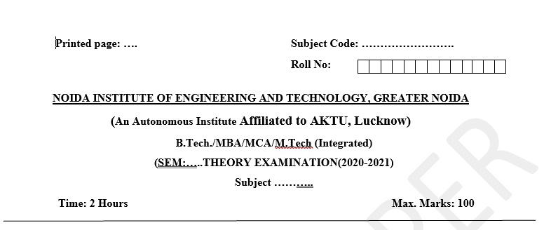
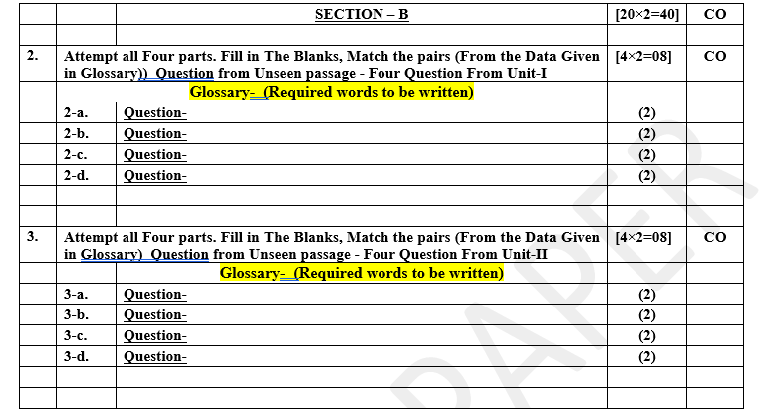
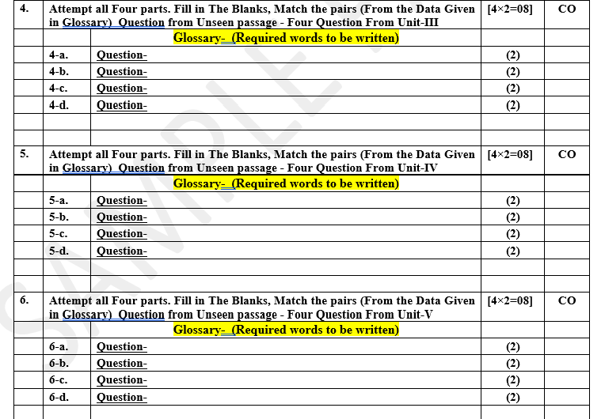
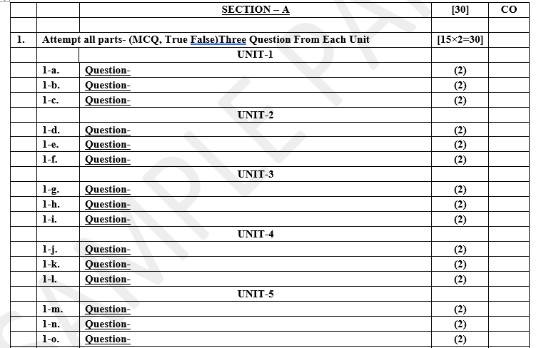
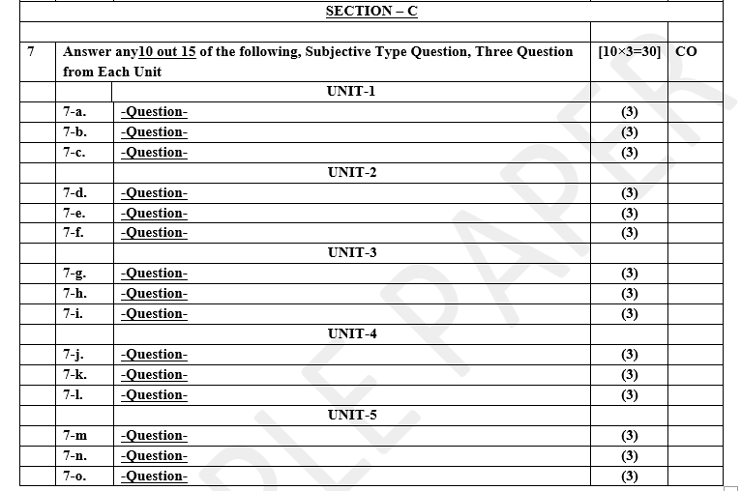
Pattern of Online External Exam Question Paper (100 marks)

Slide 14
Prerequisite and Recap
Pre-requisites: Understanding of Universal Human Goal, Human as a coexistence of Self & body and their requirements, 9 feelings of relationship, Maslow’s hierarchy of needs
Recap:
Human is combination of Self and body
Need of self can not be fulfilled by physical facility
Needs of body can not be fulfilled by feelings
Trust is foundation value
Love is complete value

Slide 15
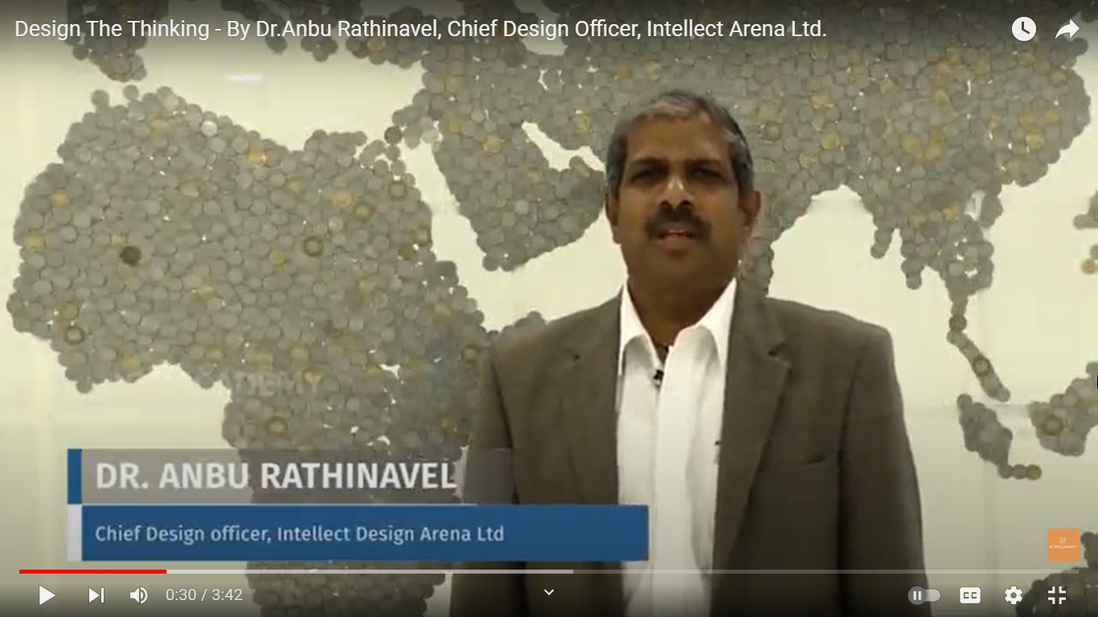
Subject Introduction
https://youtu.be/Eu80OPztGGw

Slide 16
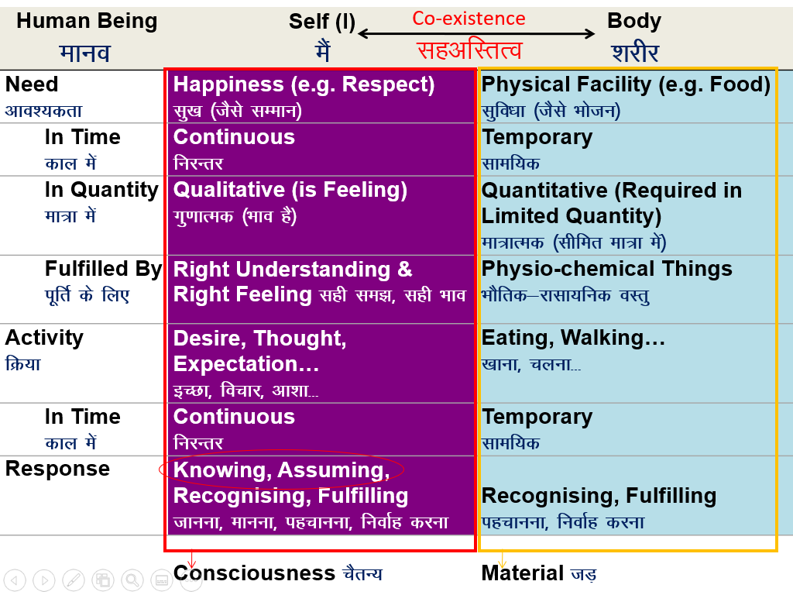
Recap: Human as a co-existence of ‘I’ (self) and body

Slide 17
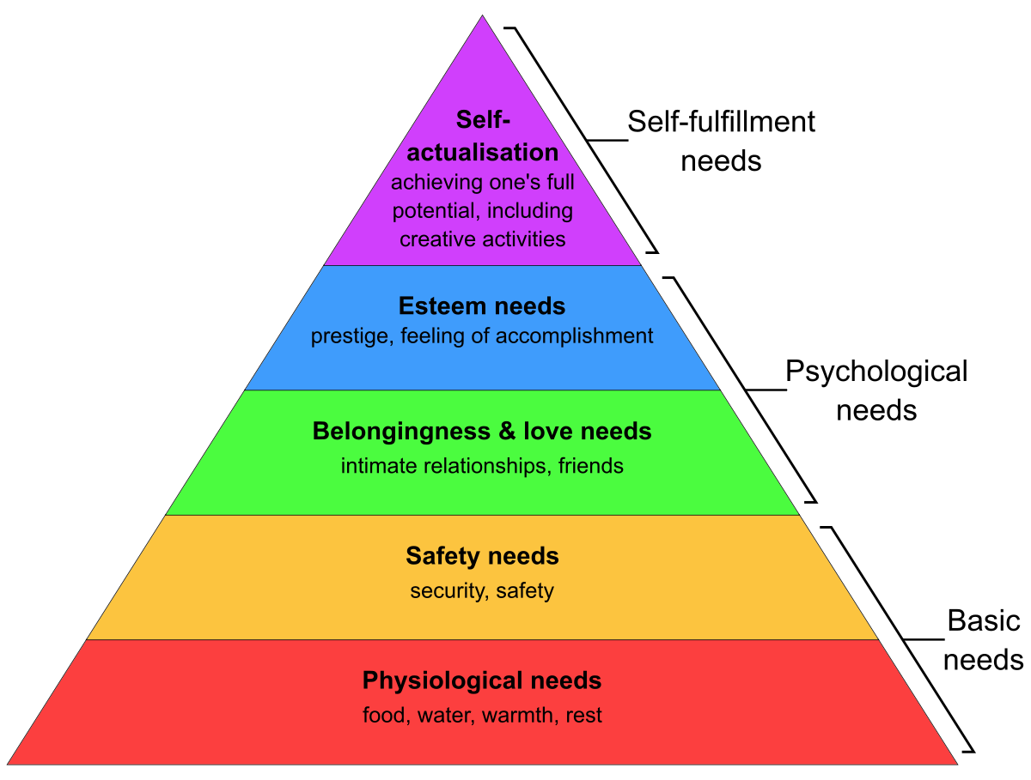
Recap: Maslow’s Hierarchy of needs (CO5)

Slide 18
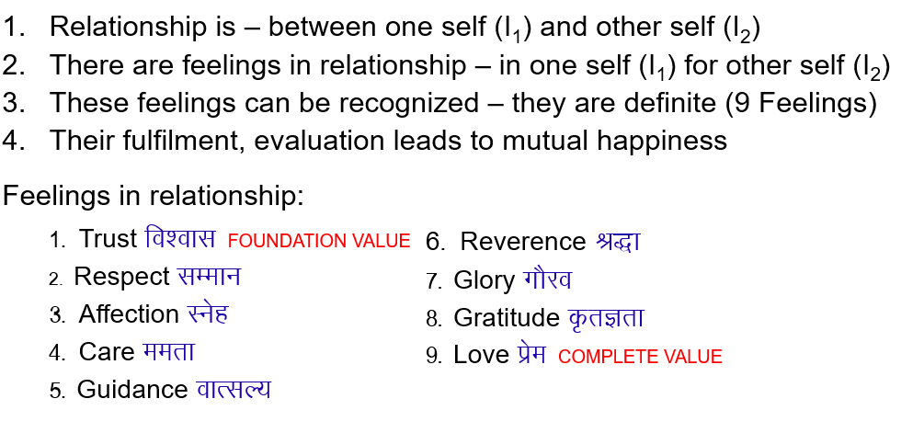
Recap: Feelings in relationship (CO5)

Slide 19
Achieve the comprehensive human goal

Slide 20
Achieve the comprehensive human goal (CO5)
Objective:
To Understand Comprehensive human goals as right understanding, prosperity, fearlessness and co-existence.
“ human desirability means identifying and prioritizing what people truly need, want, and value when designing products, services, or solutions. It ensures that the outcome aligns with users' preferences and emotions, making it attractive and relevant to them. In design thinking, desirability is the starting point that drives innovation by focusing on human-centered insights and empathy. “

Slide 21
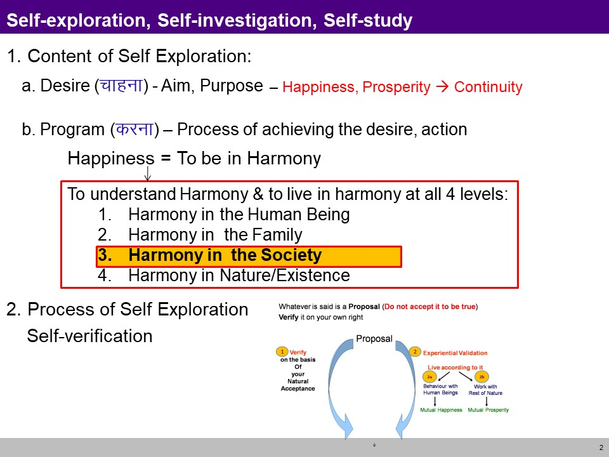
Achieve the comprehensive human goal (CO5)

Slide 22
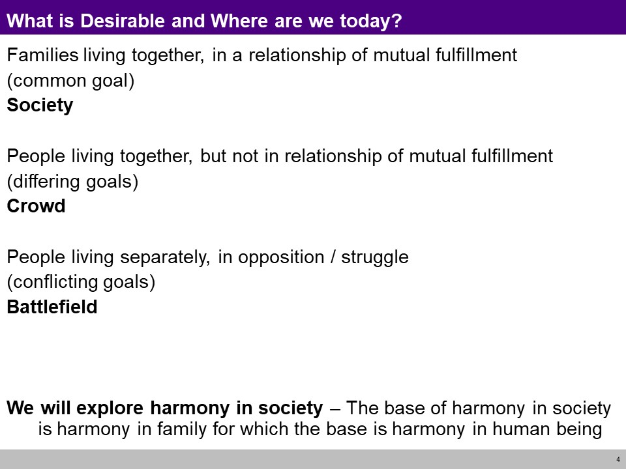
Achieve the comprehensive human goal (CO5)

Slide 23
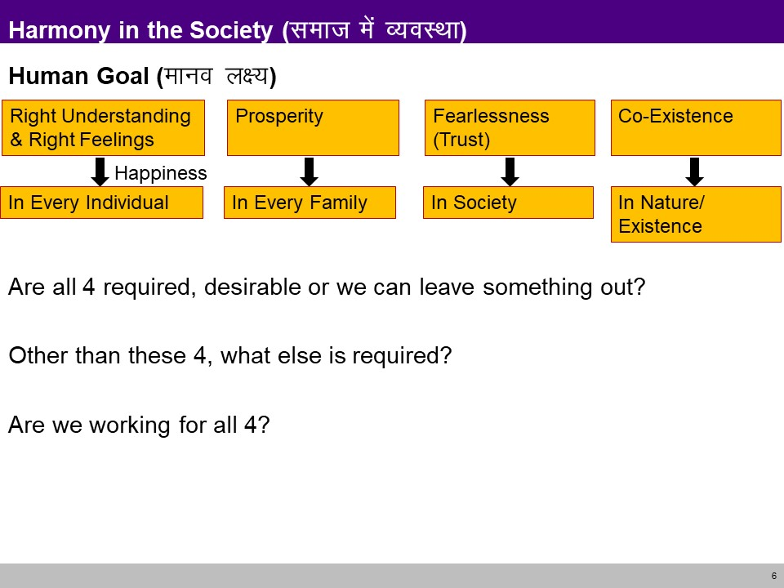
Achieve the comprehensive human goal (CO5)

Slide 24
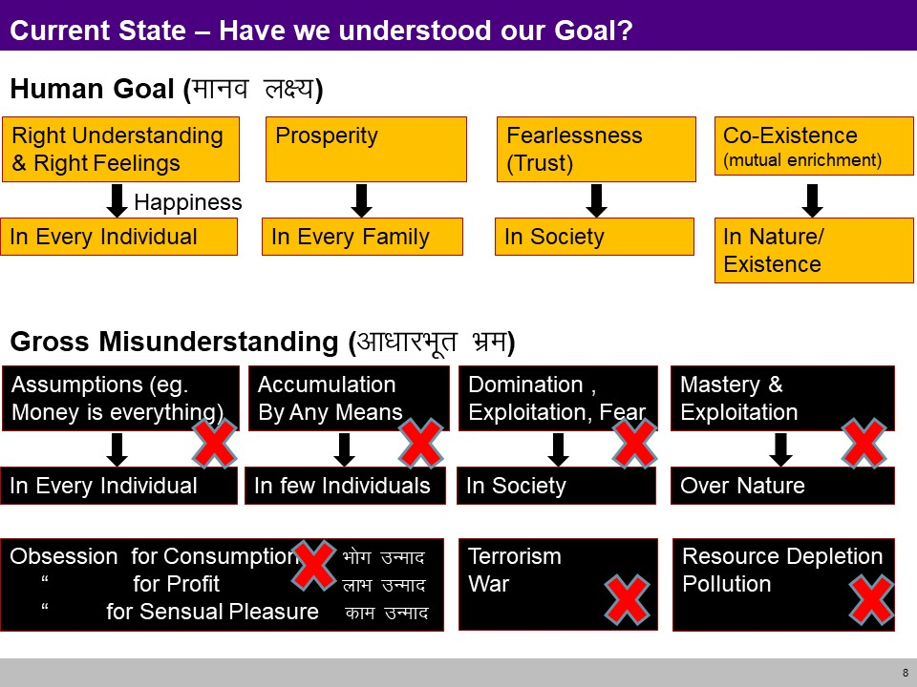
Achieve the comprehensive human goal (CO5)

Slide 25
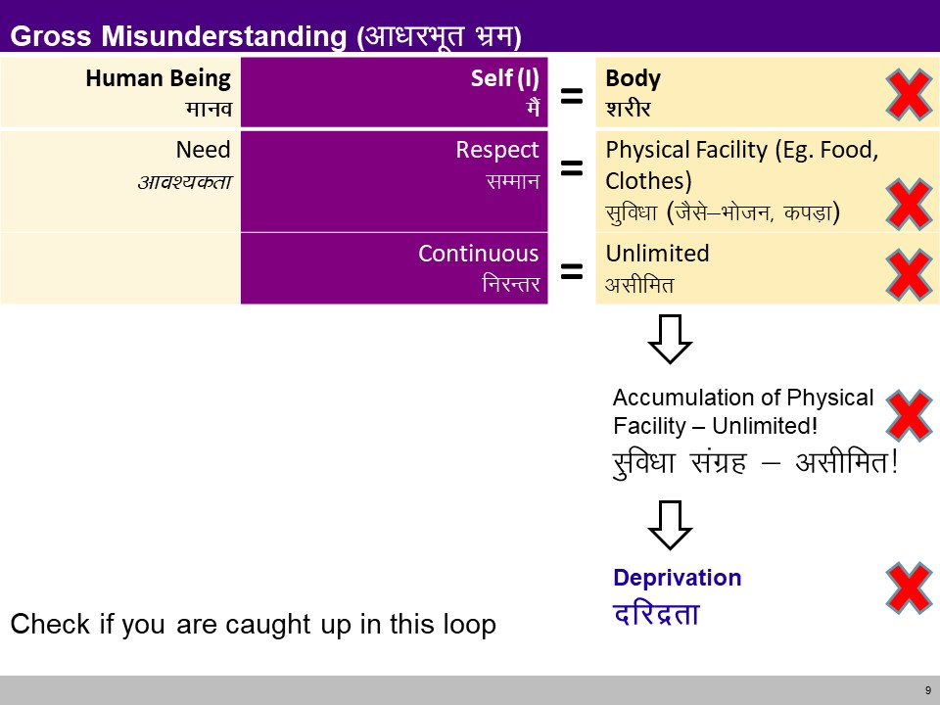
Achieve the comprehensive human goal (CO5)

Slide 26
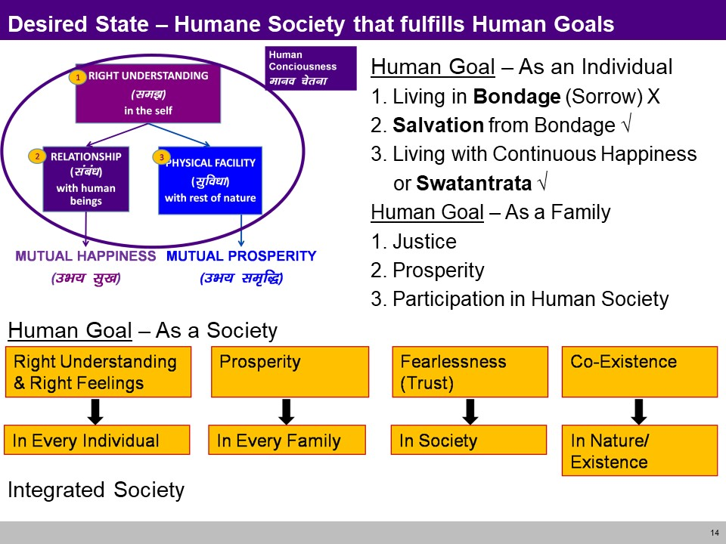
Achieve the comprehensive human goal (CO5)

Slide 27
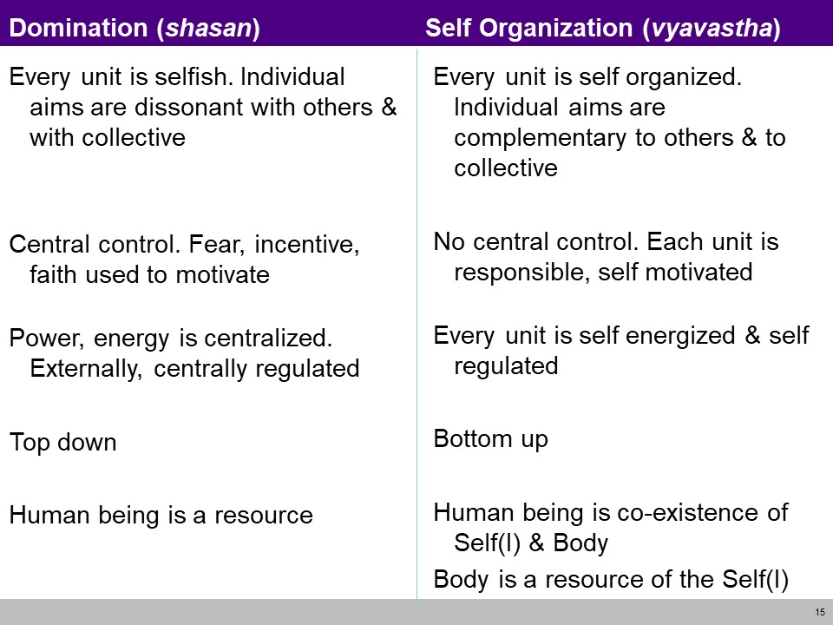
Achieve the comprehensive human goal (CO5)

Slide 28
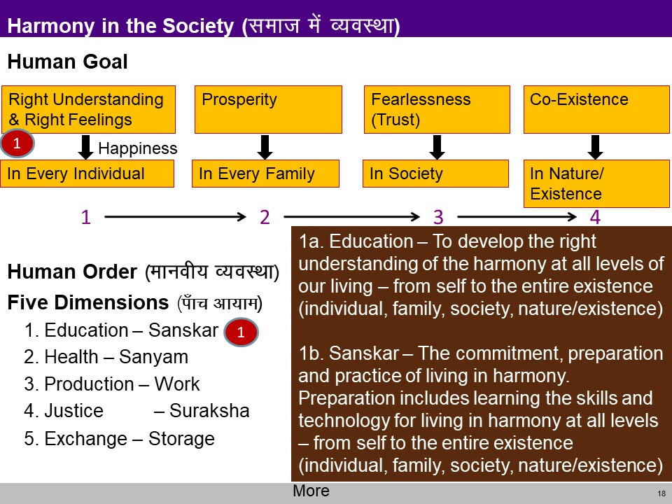
Achieve the comprehensive human goal (CO5)

Slide 29
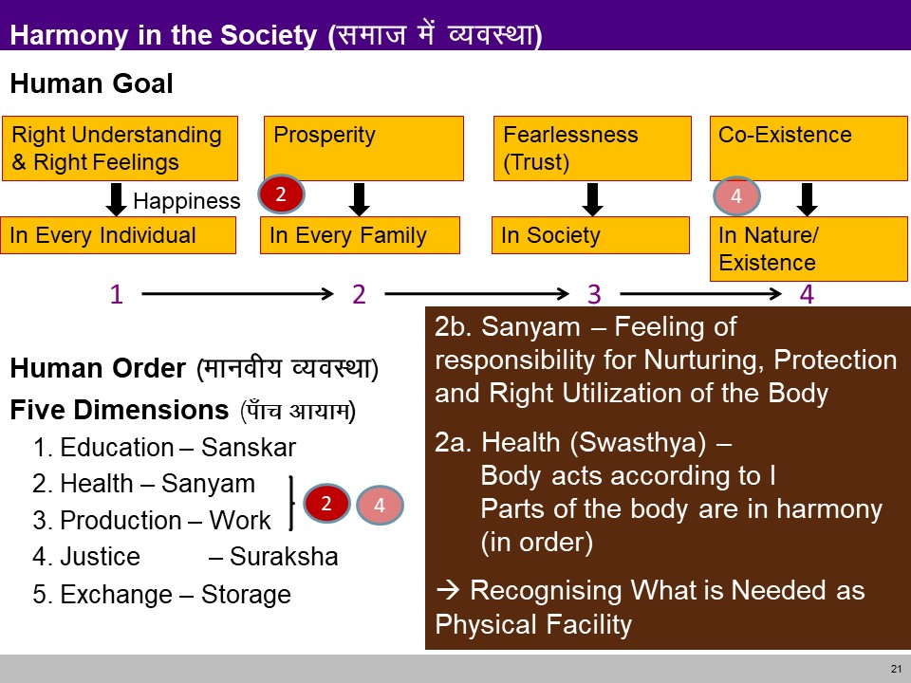
Achieve the comprehensive human goal (CO5)

Slide 30
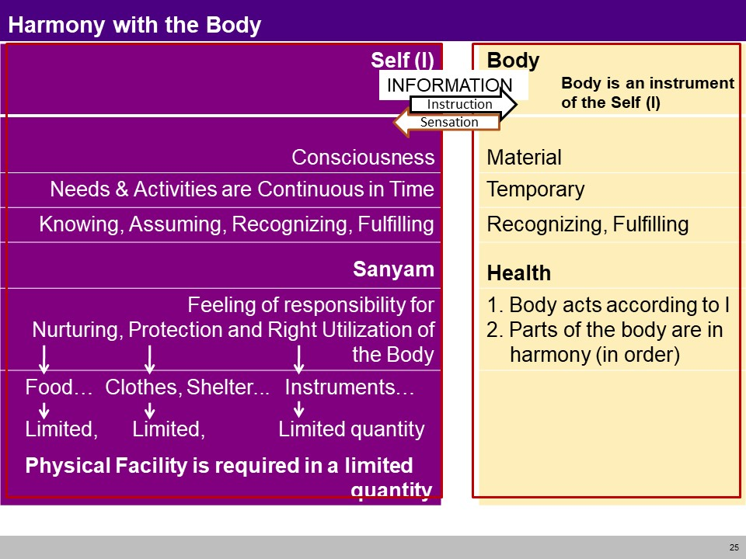
Achieve the comprehensive human goal (CO5)

Slide 31
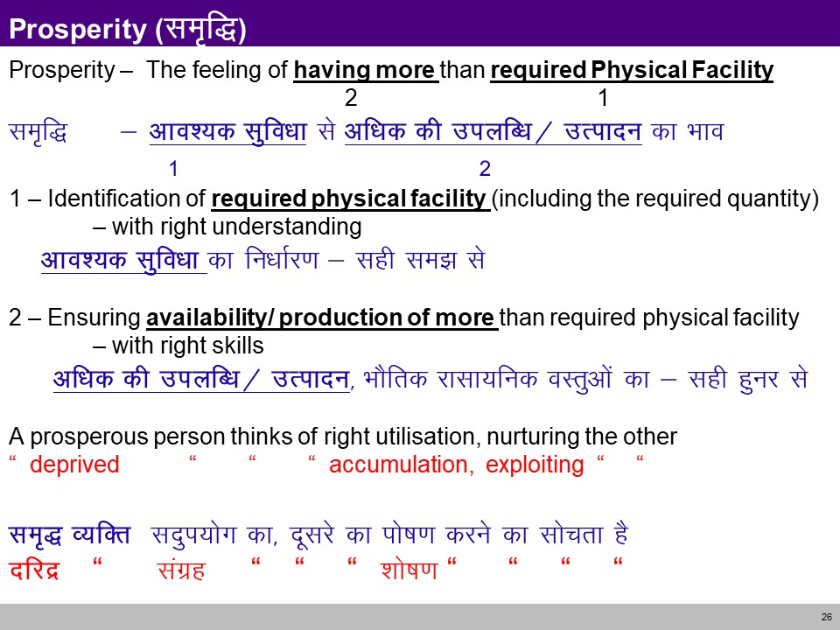
Achieve the comprehensive human goal (CO5)

Slide 32
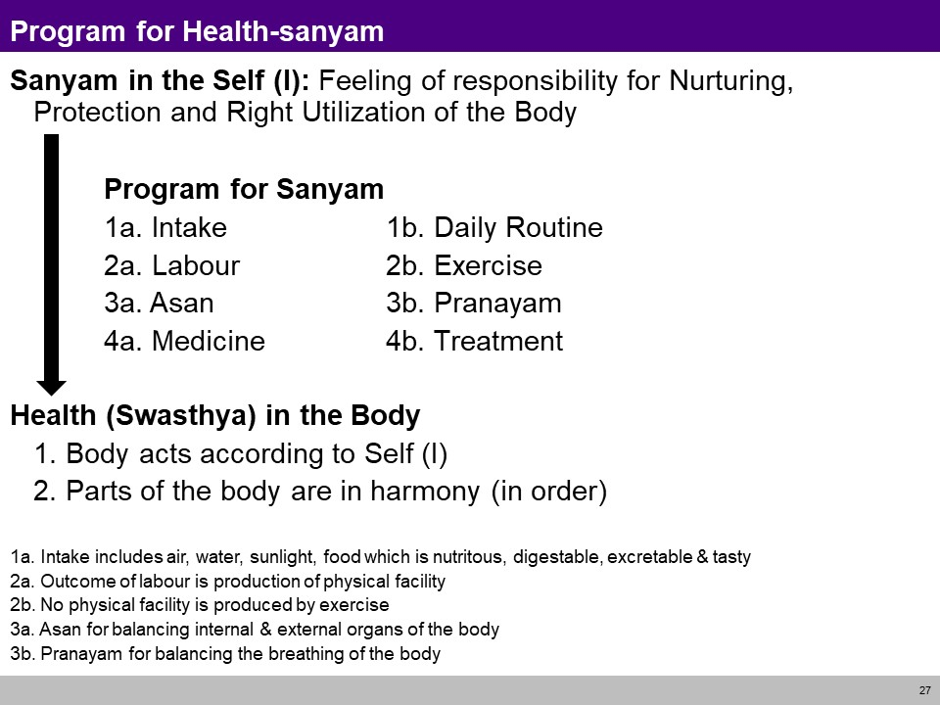
Achieve the comprehensive human goal (CO5)

Slide 33
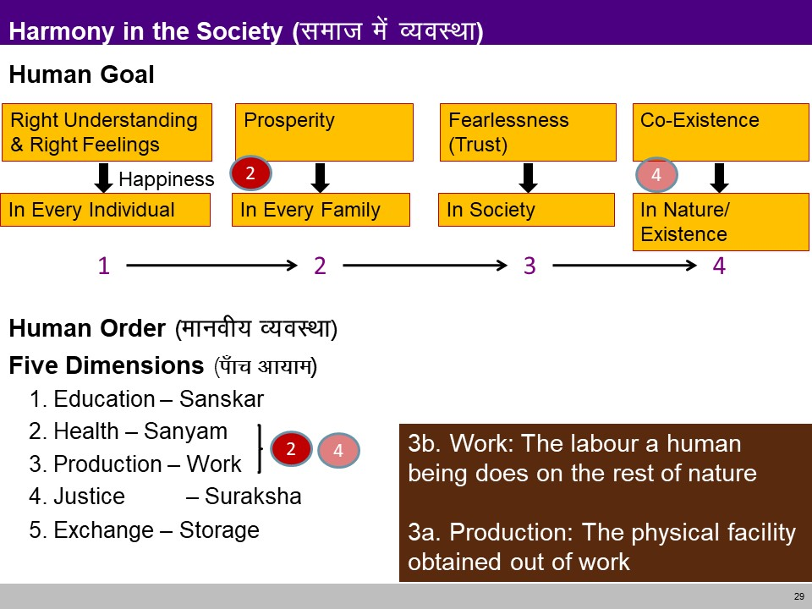
Achieve the comprehensive human goal (CO5)

Slide 34
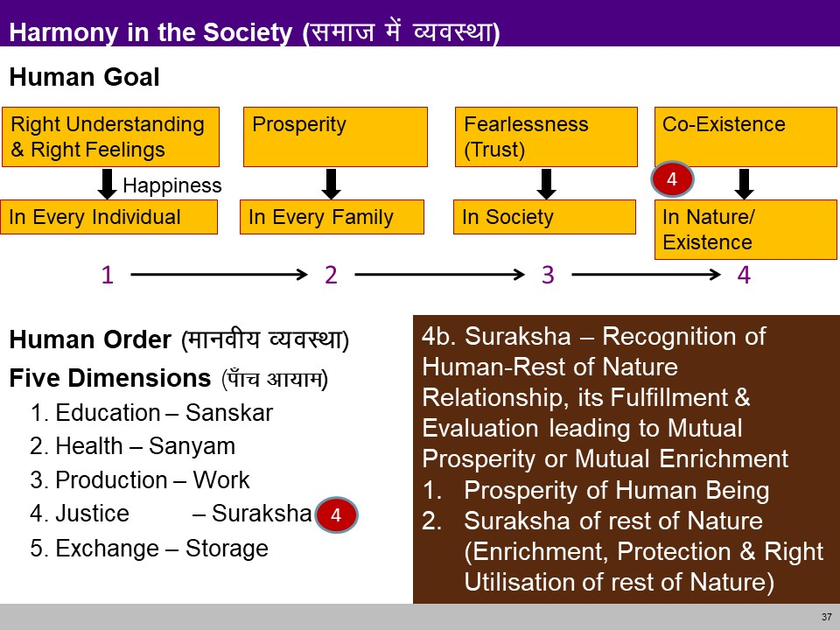
Achieve the comprehensive human goal (CO5)

Slide 35
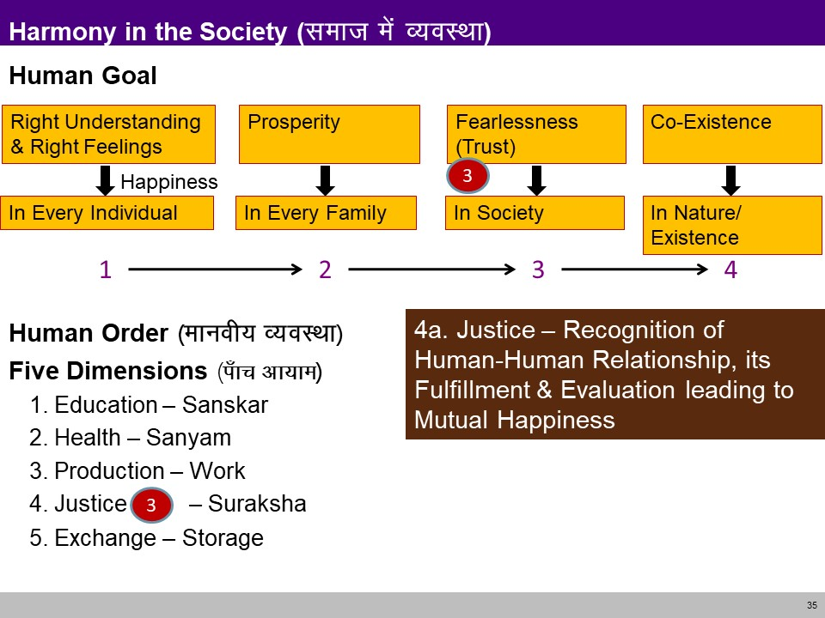
Achieve the comprehensive human goal (CO5)

Slide 36
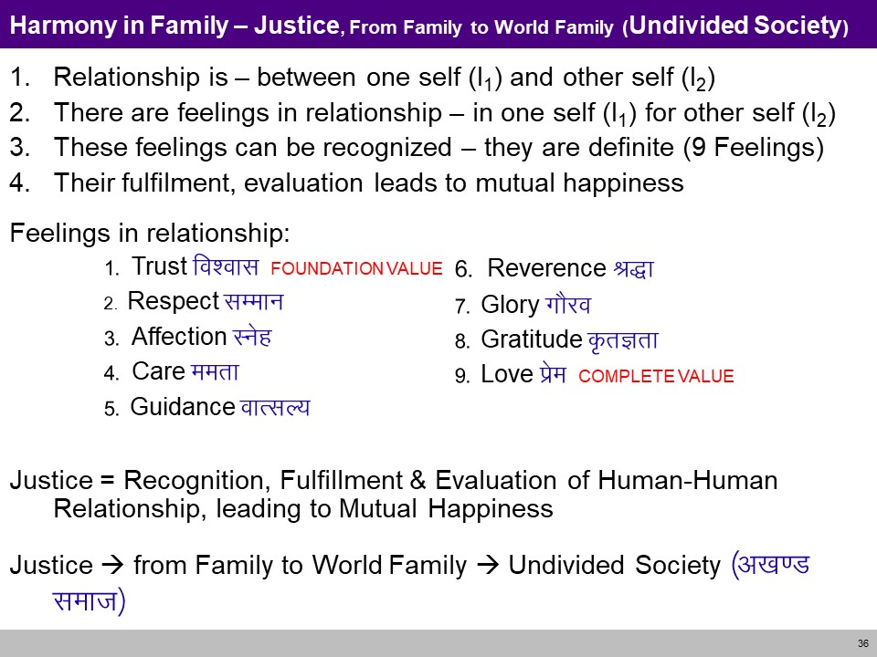
Achieve the comprehensive human goal (CO5)

Slide 37
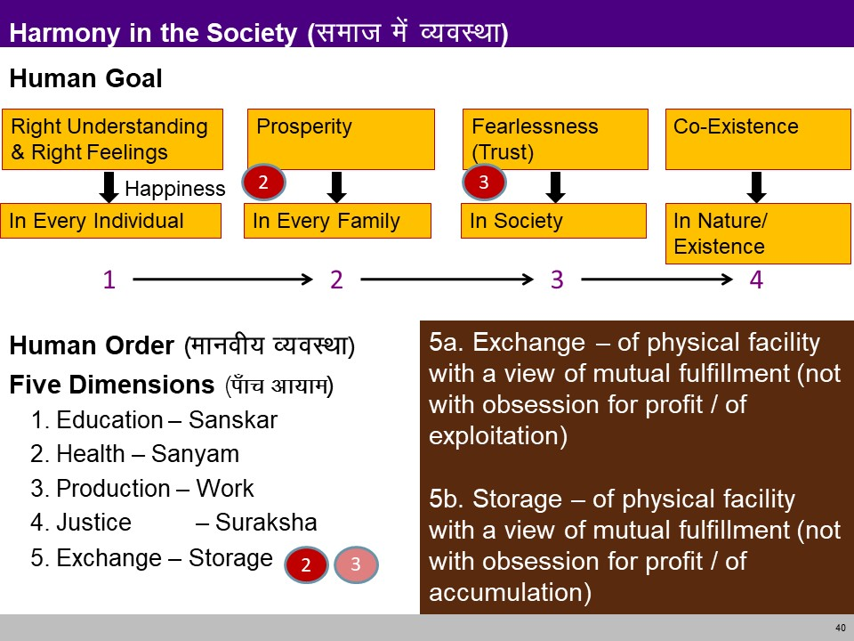
Achieve the comprehensive human goal (CO5)

Slide 38
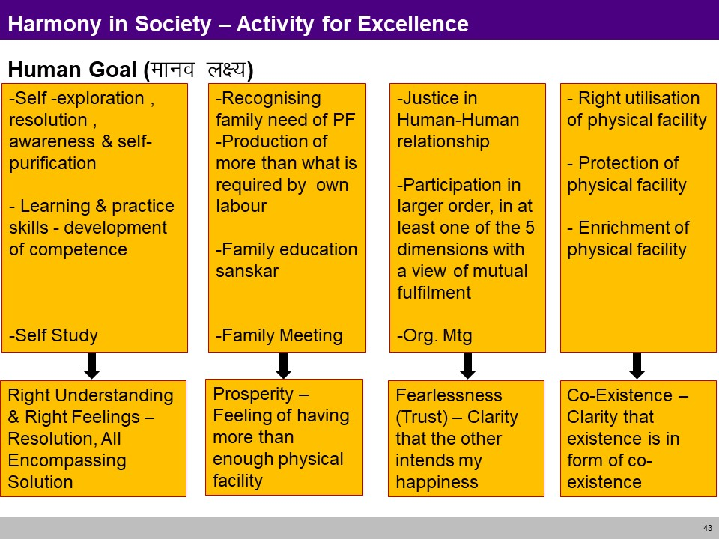
Achieve the comprehensive human goal (CO5)

Slide 39
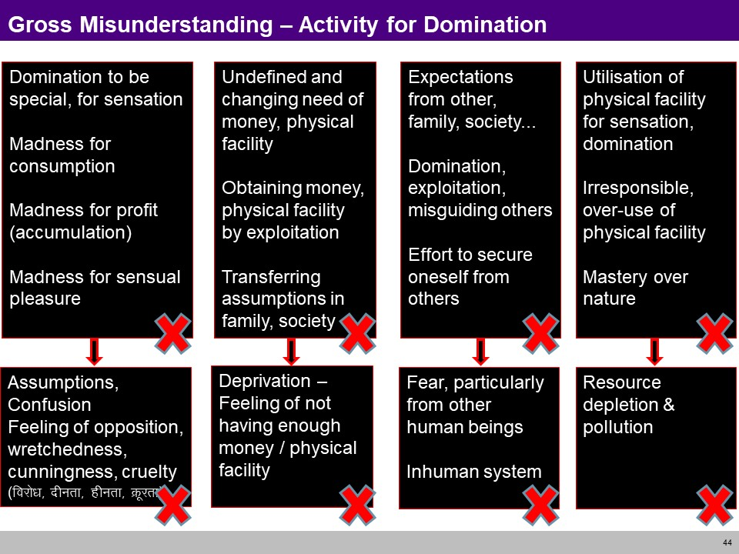
Achieve the comprehensive human goal (CO5)

Slide 40
Darshan Gyan Charitra (Shifting the Thinking)

Slide 41
Darshan, Gyan, Charitya(CO5)
Objective:
To Understand Samyak-Darshan refers to Right View or Right Belief whereas Samyak-Gyan refers to Right Knowledge

Slide 42
Darshan, Gyan, Charitya(CO5)
Theory of Knowledge (Gyan)
Knowledge is eight types Matijnana , Shrutajnana , Avadhijnana , Manahparyayajnana , Keval jnana , and three ignorance, Kumati , Kushruta , Kuavadhi
Darshan is four types Chaksu , Achaksu, Avadhi , Kevala
Right conduct - Samyak charitra
This means living your life according to Jain ethical rules, to avoid doing harm to living things and freeing yourself from attachment and other impure attitudes and thoughts.

Slide 43
Gyan (CO5)
The Jain, scholars divide cognition or knowledge into two divisions viz. -
Valid knowledge
Fallacious knowledge
The valid knowledge is of five types viz. -
Sensory knowledge (Mati Jnana)
Scriptural knowledge (Shruta Jnana)
Clairvoyance (Avadhi Jnana)
Telepathy (manahparyaya jnana)
Omniscience (Kevala Jnana)
The fallacious knowledge is of three types viz. -
Kumati,
Kusruta
Vibhang

Slide 44
Gyan (CO5)
The valid knowledge
Sensory knowledge (Mati Jnana)
Scriptural knowledge (Shruta Jnana)
Clairvoyance (Avadhi Jnana)
Telepathy (manahparyaya jnana)
Omniscience (Kevala Jnana)

Slide 45
Gyan (CO5)
The valid knowledge
Mati jnana or sensuous knowledge is ordinary cognition, obtained by normal functioning of sense perception. It is based on sensuous perception. According to the ancient texts, mati jnana is described as synonymous with intelligence and it includes remembrance, recognition and inductive as well as deductive reasoning. "Mati jnana is sometimes further distinguished into three kinds viz. upalabdhi or perception, bhavana or memory, and upyoga or understanding".
Shruta jnana or authoritative knowledge is knowledge derived through symbols, signs or words. All verbal knowledge is shruta jnana. It includes all canonical, scriptural or both knowledge. "Shruta jnanais of four kinds, namely,
labdhi or association,
bhavana or attention,
upayoga or understanding, and
naya or aspects of the meaning of things".
Shruta jnana is invariably preceded by mati jnana. As we saw, mati jnana cognizes only what is present, the shruta jnana comprehends, all the three time dimensions (past, present and future) relating to the object. "While mati jnana gives us knowledge by acquaintance, this (shruta) gives us knowledge by description.”

Slide 46
Gyan (CO5)
The valid knowledge
Avadhi jnana or clairvoyant is a sort of clairvoyant knowledge or direct visual intuition which enables a person to know things or objects even at a distance of time or space, without their coming into contact with sense organs.
Manah paryaya or telephathic knowledge is a direct knowledge of the thoughts of the minds of others. It is without the help of any medium or agency. Just like avadhi jnana, manah paryaya jnana is an extra sensory perception. Manah paryaya can not be attained by ordinary persons. Only a soul in its higher progression stage or at its higher 'guna-sthana' may acquire this type of knowledge.
Keval jnana or perfect knowledge "comprehends all substances and their modifications." It is the pure, absolute, complete, whole and total knowledge unlimited by space, time or object. It is the very omniscience. Omniscience according to Jainism is possible, it is the highest type of perception which falls in the category of extra-sensory perception. It is the perception of the cognising faculty of self. Keval jnana is possible only when all the jnana obscuring karmas have been totally annihilated. It is independent of senses, can be only felt and cannot be described. This supreme and unlimited knowledge is possessed only by purified souls free from bondage like Arihants and Siddhas.

Slide 47
Gyan (CO5)
The fallacious knowledge
Kumati: Wrong sensory knowledge
Kusruta: Wrong scriptural knowledge
Vibhang: wrong divining

Slide 48
Darshan (CO5)
Darshan is of four kinds
Chaksu visual apprehension
Achaksu non visual apprehension with the aid of mind, ear, nose, tongue and skin.
Avadhi apprehension directly by the soul without the aid of senses and mind.
Clairvoyance Kevala perfect apprehension by the soul.

Slide 49
Charitra (CO5)
Right faith and right knowledge are prerequisite to right conduct.
Right conduct is essential for self realization or liberation, or for success in life.
Right conduct requires observance of austerities, e. g. simple living and high thinking
Checking of external activities of body, mind and speech, i.e. checking distraction of attention
Meditation and contemplation on the true nature of the soul, or the goal
Right conduct is of two categories:
1 . Sakal Samyagcharitra rules of conduct are followed with vigor, Mahavratas . This is for ascetics
2 . Vikal Samyagcharitra rules are followed as much as possible, Anuvratas . This is for householders
Besides following the rules the person should absent from vices.

Slide 50
Interconnectedness and mutual fulfilment among the four orders of nature recyclability and self-regulation in nature

Slide 51
Interconnectedness and mutual fulfilment among the four orders of nature (CO5)
Objective:
To Understand interconnectedness and mutual fulfilment in all the orders of nature except human order

Slide 52
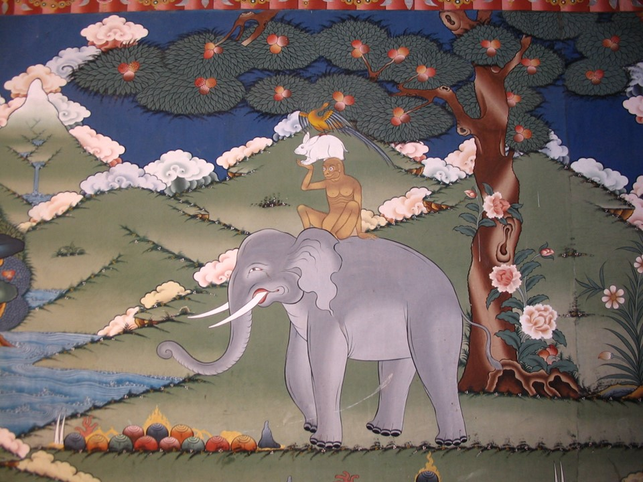
Interconnectedness and mutual fulfilment among the four orders of nature (CO5)

Slide 53
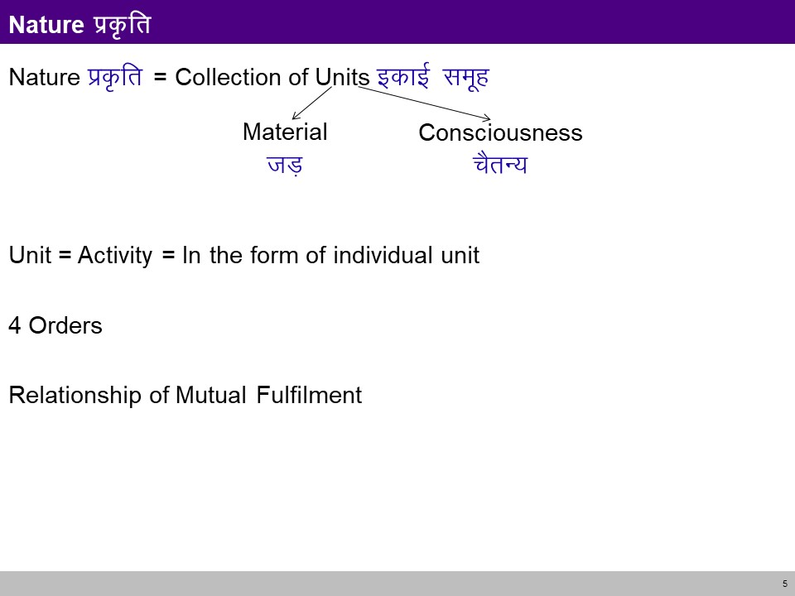
Interconnectedness and mutual fulfilment among the four orders of nature (CO5)

Slide 54
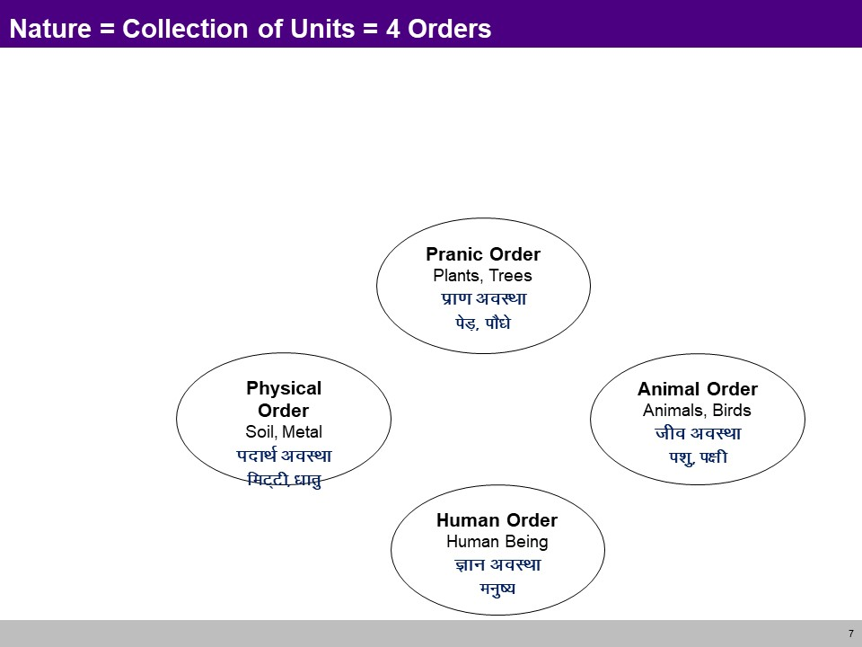
Interconnectedness and mutual fulfilment among the four orders of nature (CO5)

Slide 55
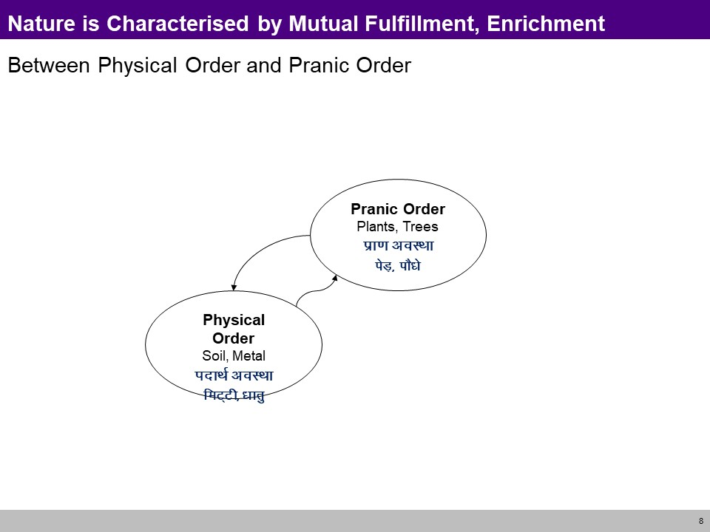
Interconnectedness and mutual fulfilment among the four orders of nature (CO5)

Slide 56
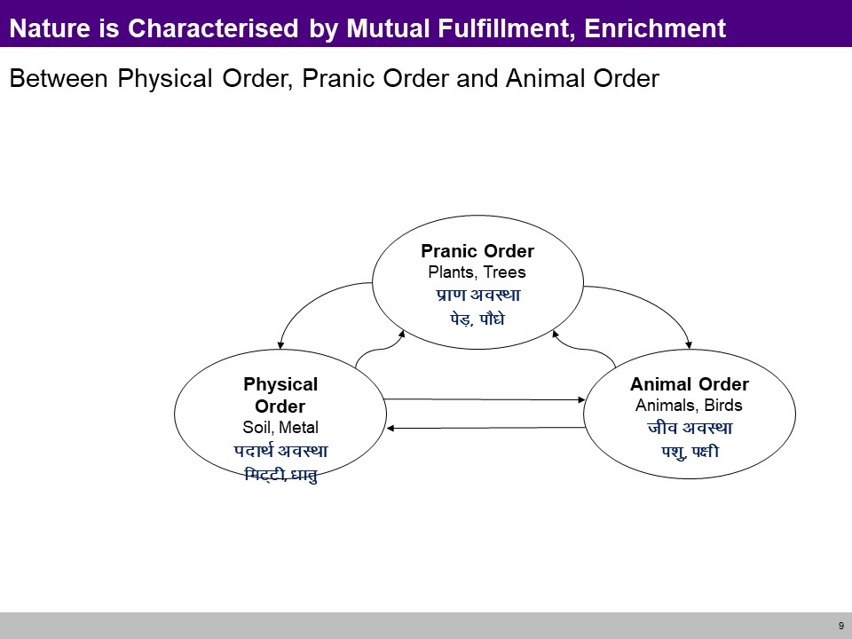
Interconnectedness and mutual fulfilment among the four orders of nature (CO5)

Slide 57
Interconnectedness and mutual fulfilment among the four orders of nature (CO5)

Slide 58
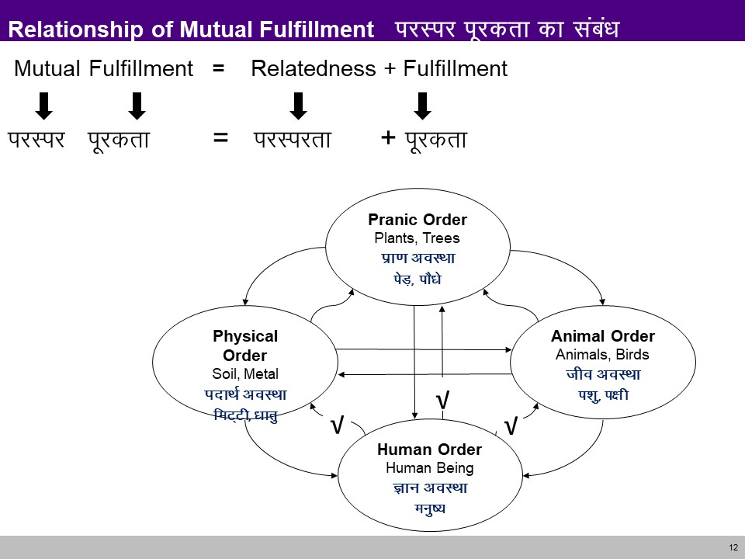
Interconnectedness and mutual fulfilment among the four orders of nature (CO5)

Slide 59
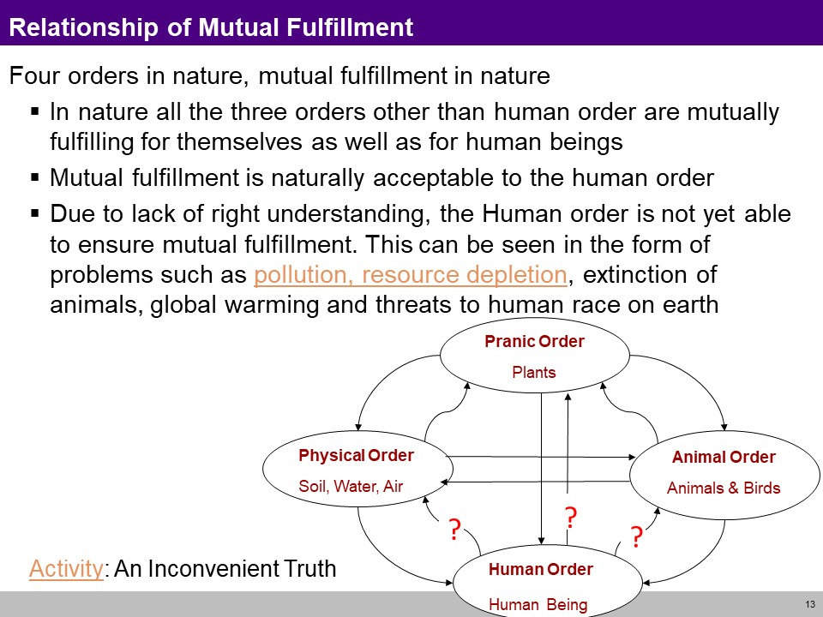
Interconnectedness and mutual fulfilment among the four orders of nature (CO5)

Slide 60
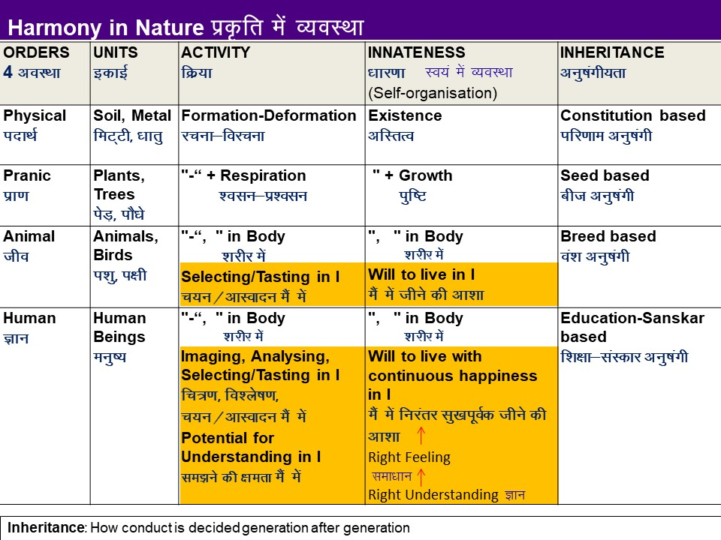
Interconnectedness and mutual fulfilment among the four orders of nature (CO5)

Slide 61
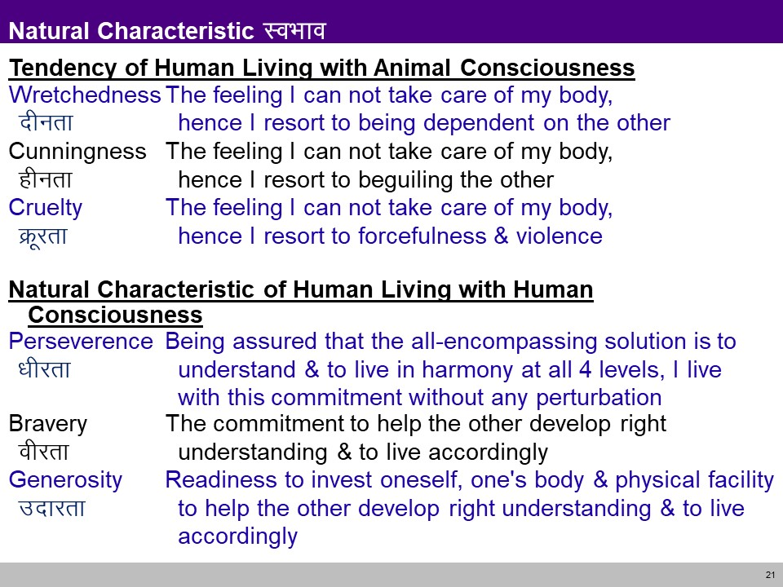
Interconnectedness and mutual fulfilment among the four orders of nature (CO5)

Slide 62
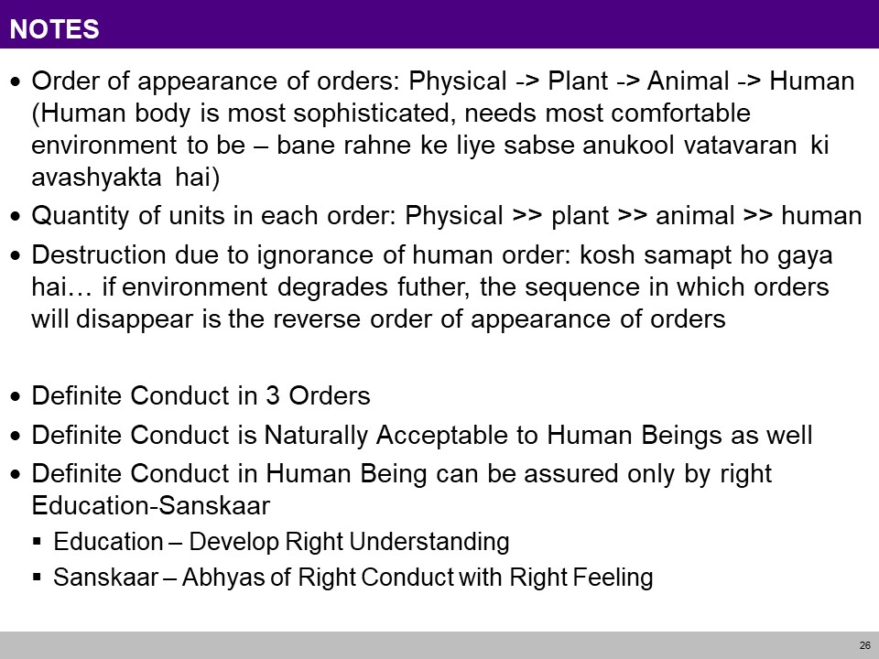
Interconnectedness and mutual fulfilment among the four orders of nature (CO5)

Slide 63
Thinking expansion for harmony

Slide 64
Johari Window model (CO5)
Objective:
To Understand Johari Window as a convenient method used to enhance communication between the members in a group

Slide 65
Johari Window model (CO5)
A Johari window is a psychological tool created by Joseph Luft and Harry Ingham in 1955.
Simple and useful tool for understanding and training:
self-awareness
personal development
improving communications
interpersonal relationships
group dynamics
team development; and
inter group relationships

Slide 66
Johari Window model (CO5)
4 Areas
Open area, open self, free area, free self, or ‘the arena‘: what is known by the person about him/herself and is also known by others
Blind area, blind self, or 'blindspot‘: what is unknown by the person about him/herself but which others know
Hidden area, hidden self, avoided area, avoided self or 'façade’: what the person knows about him/herself that others do not know
Unknown area or unknown self: what is unknown by the person about him/herself and is also unknown by others

Slide 67
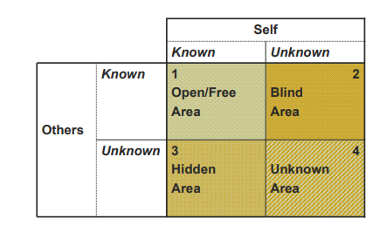
Johari Window model (CO5)
4 Areas

Slide 68
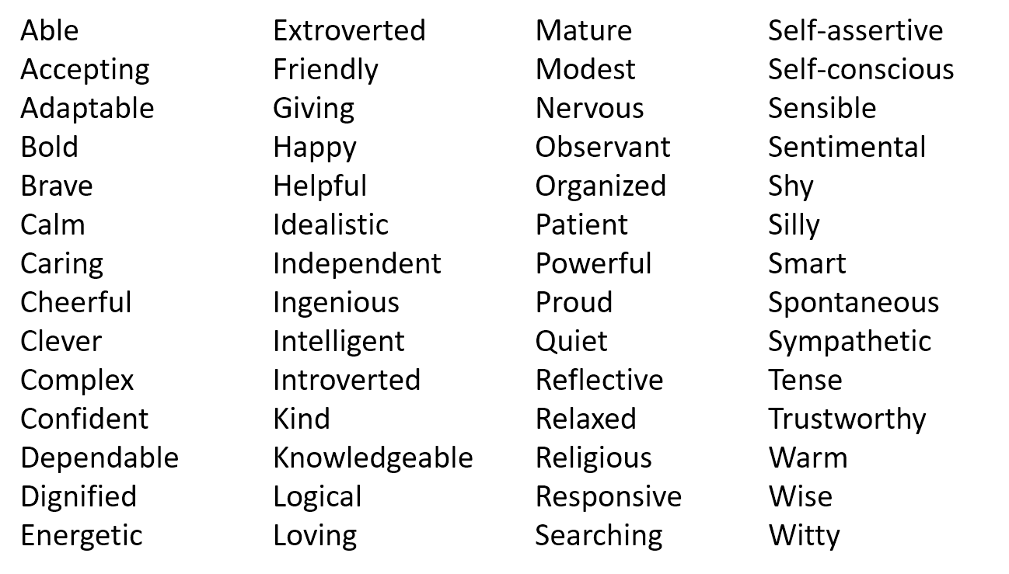
Johari Window model (CO5)
Exercise :
Step 1. Self Assessment:
Using the following list choose 5 adjectives that best describe yourself. Be objective and honest.

Slide 69
Johari Window model (CO5)
Exercise :
Step 2: Assessing Teammates
Once everyone has finished their own self-assessment, the entire team will evaluate their colleagues.
Assess your teammates with the same criteria you evaluated yourself. Remember to choose only 5 and to be both honest and objective.
Step 3 : Fill In the Johari Window Panes

Slide 70
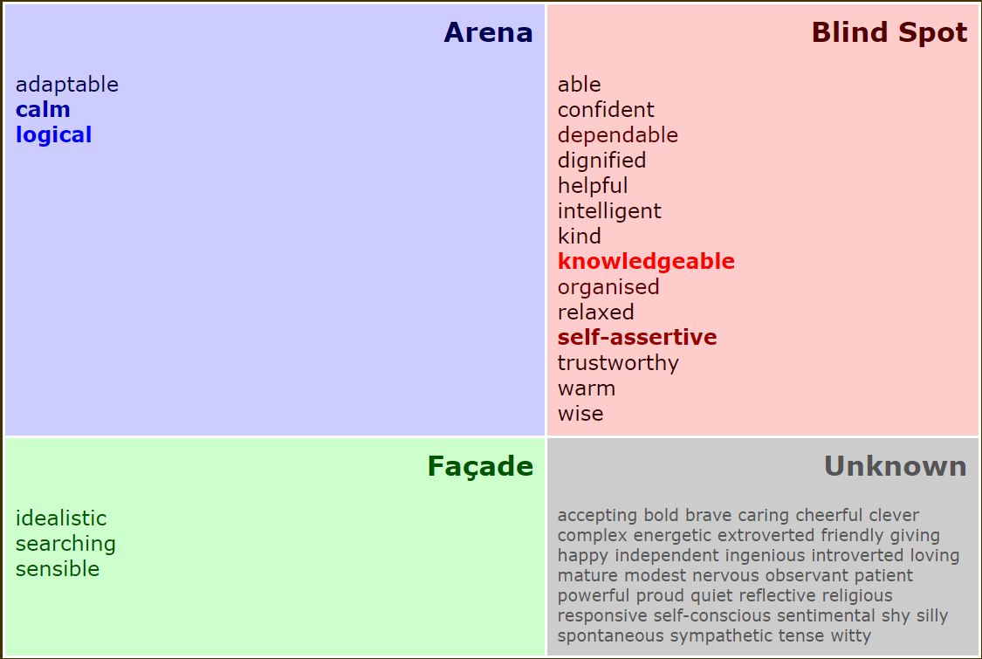
Johari Window model (CO5)
Open Area
Hidden Area

Slide 71
Group Behaviour (CO5)
Group behaviour refers to the situations where
people interact inside small groups, for example to reach or not a consensus and act in a coordinated way. This is the field of group dynamics.
large number of people in a given area behave simultaneously in similar way and have a similar goal, that might be different from what they would do individually (herd behaviour).

Slide 72
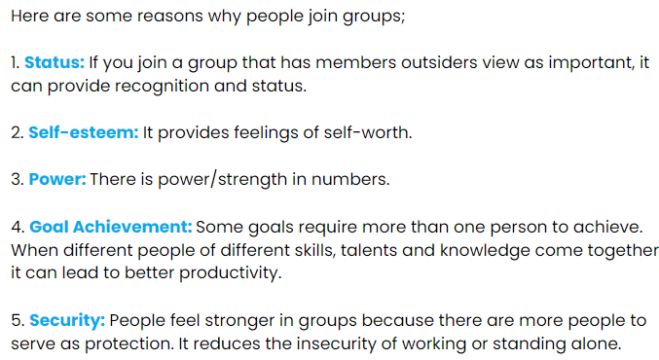
Group Behaviour (CO5)

Slide 73

Group Behaviour: Types (CO5)
5 Types of Group Behaviour

Slide 74
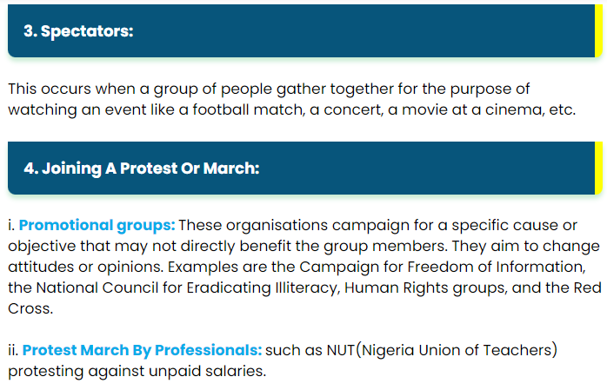
Group Behaviour: Types (CO5)
5 Types of Group Behaviour

Slide 75

Group Behaviour: Types (CO5)
https://i.imgur.com/w8sHpP6.png

Slide 76
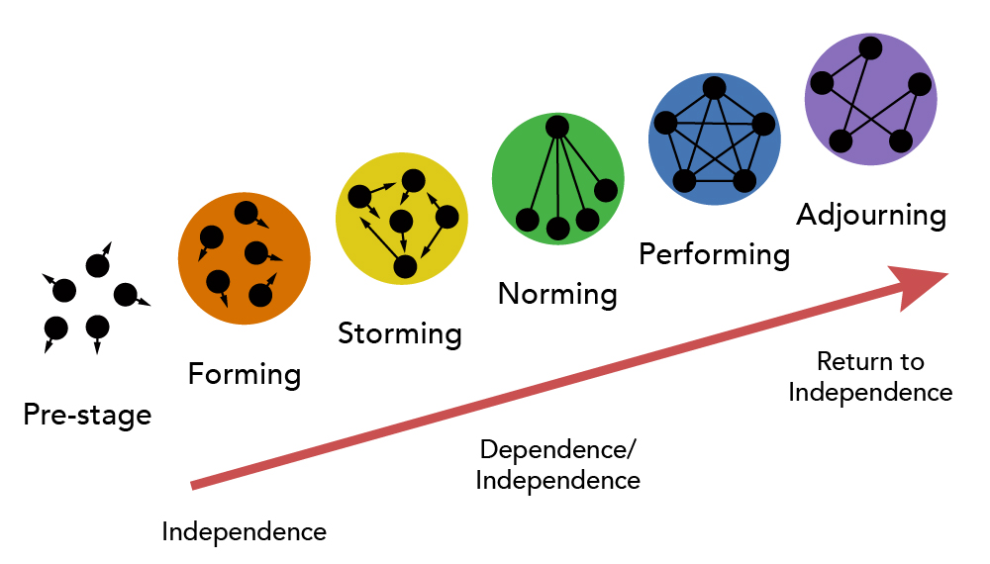
Group Behaviour: Tuckman’s Theory (CO5)
Tuckman’s theory was first proposed by psychologist Bruce Tuckman in 1965. It stated that teams would go through 5 stages of development:
forming,
storming,
norming,
performing and
adjourning.

Slide 77
Group Behaviour: Tuckman’s Theory (CO5)
Forming
The initial forming stage is the process of putting the structure of the team together.
Team members feel ambiguous and conflict is avoided at all costs due to the need to be accepted into the group.
Storming
This stage begins to occur as the process of organizing tasks and processes surface interpersonal conflicts.
Leadership, power, and structural issues dominate this stage.
Norming
In this stage, team members are creating new ways of doing and being together.
As the group develops cohesion, leadership changes from ‘one’ teammate in charge to shared leadership.
Team members learn they have to trust one another for shared leadership to be effective.

Slide 78
Group Behaviour: Tuckman’s Theory (CO5)
Performing
True interdependence is the norm of this stage of group development.
The team is flexible as individuals adapt to meet the needs of other team members.
This is a highly productive stage both personally and professionally.
Adjourning
In this stage typically team members are ready to leave (course termination) causing significant change to the team structure, membership, or purpose and the team during the last week of class.
They experience change and transition.
While the group continues to perform productively they also need time to manage their feelings of termination and transition.

Slide 79
Interpersonal behaviour and skills

Slide 80
Interpersonal behaviour and skills (CO5)
Objective:
To Understand Interpersonal skills related to the knowledge of social expectations and customs.

Slide 81
Interpersonal behaviour and skills (CO5)
Interpersonal skills are the behaviors and tactics a person uses to interact with others effectively.
In the business world, the term refers to an employee's ability to work well with others.
Interpersonal skills range from communication and listening to attitude and deportment.

Slide 82
Interpersonal behaviour and skills (CO5)
Eight interpersonal skills
1) Exercising Self-Awareness. ...
2) Being Cognizant of Nonverbal Communication.
3) Being Respectful of Others. ...
4) Showing Empathy and Understanding. ...
5) Being a Clear Communicator. ...
6) Engaging in Active Listening.
7) Behaving Appropriately
8) Being Receptive to Feedback
Notes:
https://bigthink.com/plus/top-8-interpersonal-skills-for-the-workplace/

Slide 83
Myers-Briggs Personality Type (CO5)
The Myers-Briggs Personality Type Indicator is a self-report inventory designed to identify a person's personality type, strengths, and preferences.
The questionnaire was developed by Isabel Myers and her mother Katherine Briggs based on their work with Carl Jung's theory of personality types.
Today, the MBTI inventory is one of the most widely used psychological instruments in the world.
Notes:
https://bigthink.com/plus/top-8-interpersonal-skills-for-the-workplace/

Slide 84
Myers-Briggs Personality Type (CO5)
4 Scales for determining MBTI personalities
Four different scales determine which one of 16 personalities you are:
Extraversion (E) and Introversion (I). We can think of extroverts and introverts as categories that are on the opposite side of the spectrum, like two extremes:
Extroverts are more action-oriented and feel energized after social interactions.
Introverts are more thought-oriented and they “charge batteries” when they’re alone.
Sensing (S) and Intuition (N). This scale refers to the way we gather information from the world around us:
Those who prefer sensing gather information from reality, facts and experience.
The ones who prefer intuition prefer impressions, possibilities, and abstract thinking.
Notes:
https://bigthink.com/plus/top-8-interpersonal-skills-for-the-workplace/

Slide 85
Myers-Briggs Personality Type (CO5)
4 Scales for determining MBTI personalities
Four different scales determine which one of 16 personalities you are:
Thinking (T) and Feeling (F). After we gather data, we process them in two ways:
Thinking, which involves logic-based processing.
Feeling, which involves emotion-based processing.
Judging (J) and Perceiving (P). This refers to our attitude toward the outside world:
Judgers prefer structure and order.
Perceivers prefer being flexible and spontaneous.
Notes:
https://bigthink.com/plus/top-8-interpersonal-skills-for-the-workplace/

Slide 86
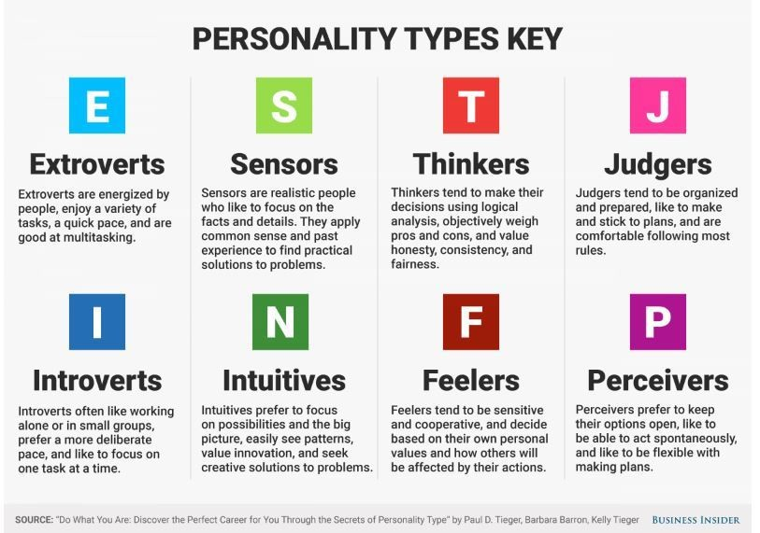
Myers-Briggs Personality Type (CO5)
Notes:
https://bigthink.com/plus/top-8-interpersonal-skills-for-the-workplace/

Slide 87
Myers-Briggs Personality Type (CO5)
The MBTI test includes four categories, and each category contains four personality types:
Analysts: INTJ (The Architect), INTP (The Logician), ENTJ (The Commander), and ENTP (The Debater).
Diplomats: INFJ (The Advocate), INFP (The Mediator), ENFJ (The Protagonist), and ENFP (The Campaigner).
Sentinels: ISTJ (The Logistician), ISFJ (The Defender), ESTJ (The Executive), and ESFJ (The Consul).
Explorers: ISTP (The Virtuoso), ISFP (The Adventurer), ESTP (The Entrepreneur), and ESFP (The Entertainer).
Notes:
https://bigthink.com/plus/top-8-interpersonal-skills-for-the-workplace/

Slide 88
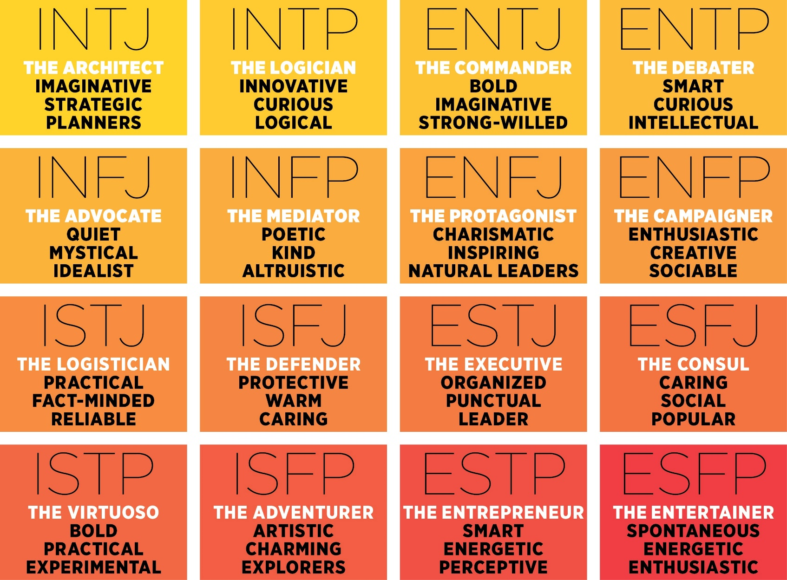
Myers-Briggs Personality Type (CO5)
Notes:
https://bigthink.com/plus/top-8-interpersonal-skills-for-the-workplace/

Slide 89
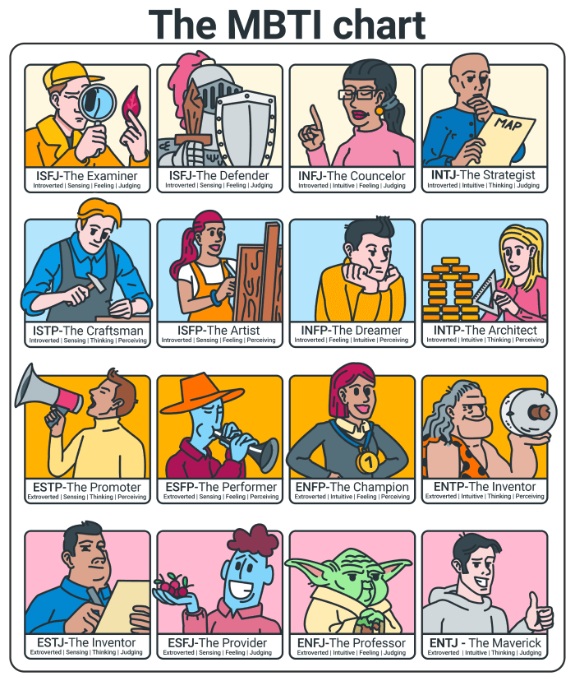
Myers-Briggs Personality Type (CO5)
Notes:
https://bigthink.com/plus/top-8-interpersonal-skills-for-the-workplace/

Slide 90
FIRO-B Test(CO5)
The FIRO-B® (Fundamental Interpersonal Relations Orientation-Behavior™) instrument helps individuals understand their behavior and the behavior of others.
The first public iteration was derived in the late 1950s by William Shutz.
The basic premise for his theory was simple: “people need people”
With the insights of an individual’s interpersonal needs it can help improve workplace interactions.
Notes:
https://bigthink.com/plus/top-8-interpersonal-skills-for-the-workplace/

Slide 91
FIRO-B Test(CO5)
The FIRO-B test includes three main areas:
Inclusion
Control
Affection
Notes:
https://bigthink.com/plus/top-8-interpersonal-skills-for-the-workplace/

Slide 92
FIRO-B Test(CO5)
Inclusion is defined by the relationships one prefers to form with others. It explains the extent of which an individual enjoys or feels an aversion to being involved and invited by others. This word can also be associated with how much attention a person prefers to have from others.
Control is a word that can often carry a negative connotation, but in reference to the definition for this assessment, this word has to do with a preference for having an influence over others. It deals with a person’s preference for making decisions and amount of responsibility one may want to have.
Affection describe individuals interpersonal need for simple one-on-one relationships. It has to do with the want to know others on a personal level or how much an individual prefers to share their personal life with others.
Notes:
https://bigthink.com/plus/top-8-interpersonal-skills-for-the-workplace/

Slide 93

FIRO-B Test(CO5)
Each area is also modified by two further factors:
Expressed Behavior
Wanted Behavior
Expressed Behavior is how comfortable we feel about exhibiting a behavior toward other people.
Wanted behavior, is related to the level we want other people to exhibit a behavior toward us.
Notes:
https://bigthink.com/plus/top-8-interpersonal-skills-for-the-workplace/

Slide 94
FIRO-B Test Questionnaire (CO5)
Double click on PDF copy to open file
Notes:
https://bigthink.com/plus/top-8-interpersonal-skills-for-the-workplace/

Slide 95
Weekly Assignment
What is Johari Window of self-awareness?
What are the four windows of self in Johari Window?
What are the main goals of Johari's Window?
What is the most common Myer Briggs personality type?
What are the 16 personality types in order?
What does FIRO-B test measure?
Why FIRO-B is important?
How do you evaluate a FIRO-B score?
How many needs and dimensions does FIRO-B provide the scores on?

Slide 96
Faculty Video Links, Youtube & NPTEL Video Links and Online Courses Details
Youtube/other Video Links
Harmony in Society: https://aktu.ac.in/hvpe/HVPE%20Video%20Lectures/UHVPE%20Lecture%2020%20(Nature%20-%204%20Orders).wmv
Human Conduct: https://aktu.ac.in/hvpe/HVPE%20Video%20Lectures/UHVPE%20Lecture%2024%20(Human%20Conduct).wmv
Jain Darshan: https://www.youtube.com/watch?v=_7juhEpbu6Q&t=1398s
interpersonal behaviour and skills: https://www.youtube.com/watch?v=xd-2nKubrhA
Johari’s Window: https://www.youtube.com/watch?v=BWii4Tx3GJk&t=130s
Myers-Briggs personality types: https://www.youtube.com/watch?v=NXcWZnQPUXw
Firo-B Test
https://www.youtube.com/watch?v=ibZ1gKJu9EM

Slide 97
MCQ s
In the Johari Window, the information about yourself that you don't know but others do is your
blind self.
unknown self.
hidden self.
open self.
In the Johari Window, the things that we know about ourselves and keep to ourselves represent our
hidden self.
blind self.
open self.
unknown self.
When you move information from the hidden self into the open self, you're
empowering.
self-disclosing.
depressed.
affirming.
The more you perceive a situation as one in which others will evaluate you, the greater your _________ will be.
self-awareness
unpredictability
self-disclosure
apprehension

Slide 98
Glossary Questions
Select the correct answer
Glossary: i) blind self ii) unknown self iii) hidden self iv) open self
A) what is known by the person about him/herself and is also known by others
B) what is unknown by the person about him/herself but which others know
C) what the person knows about him/herself that others do not know
D) what is unknown by the person about him/herself and is also unknown by others
Select the correct answer
Glossary: i) Inclusion ii) Control iii) Affection iv) self disclosing
A) moving information from the hidden self into the open self
B) relationships one prefers to form with others
C) person’s preference for making decisions and amount of responsibility one may want to have
D) individuals interpersonal need for simple one-on-one relationships

Slide 99
Glossary Questions
Select the correct answer
Glossary: i) Chaksu ii) Achaksu iii) Avadhi iv) Kevala
A) perfect apprehension by the soul without the aid of senses and mind
B) apprehension directly by the soul without the aid of senses and mind
C) non visual apprehension with the aid of mind, ear, nose, tongue and skin.
D) visual apprehension with the aid of eyes.
Select the correct answer
Glossary: i) Extraversion ii) Introversion iii) Sensing iv) Intuition
A) Those who prefer sensing gather information from reality, facts and experience.
B) The ones who prefer intuition prefer impressions, possibilities, and abstract thinking.
C) Those who are more thought-oriented and they “charge batteries” when they’re alone.
D) Those who are are more action-oriented and feel energized after social interactions.

Slide 100
Expected Questions for University Exam
What is sanyam? How is it necessary in ensuring svasthya?
What is the responsibility of the self towards the body? How is it fulfilled?
What is meaning of justice in human relationships? How does it follow from family to world family?
What are the five dimensions of human endeavour in society conducive to ‘manaviya vyavastha’?
What is Samyak Darshan in Jainism?
Describe the concept of Triratna of Jain Philosophy.
What are the four windows of self in Johari Window?
What does FIRO-B test measure?

Slide 101

Old Question Papers
Question Paper

Slide 102

Old Question Papers

Slide 103

Old Question Papers

Slide 104

Old Question Papers

Slide 105

Old Question Papers

Slide 106

Old Question Papers

Slide 107

Old Question Papers

Slide 108

Old Question Papers

Slide 109
Summary
Achieve the comprehensive human goal: the five dimensions of human endeavour(Manaviya Vyavstha) are:
Education- Right living (Sikhsa- Sanskar),
Health – Self-regulation (SwasthyaSanyam),
Justice – Preservation (Nyaya- Suraksha),
Production – Work ( Utpadan – Karya),
Exchange – Storage (Vinimya – Kosh),
Darshan-Gyan-Charitra (Shifting the Thinking)
Interconnectedness and mutual fulfilment among the four orders of nature recyclability and self-regulation in nature
Thinking expansion for harmony:
Self-exploration (Johari’s window),
group behaviour,
interpersonal behaviour and skills,
Myers-Briggs personality types (MBTI),
FIRO-B test to repair relationships.

Slide 110
Summary
The Comprehensive Human Goal aims to create a balanced, fulfilling life for individuals and society through five key areas of human endeavour
Education (Shiksha-Sanskar): Developing knowledge, skills, and values for a meaningful life.
Example: Schools and parents teaching children values like honesty and respect alongside academic skills.
Health (Swasthya-Sanyam): Ensuring physical and mental well-being through healthy practices and self-discipline.
Example: Regular exercise, healthy diet, and stress management as part of a balanced lifestyle.
Justice (Nyaya-Suraksha): Creating a fair and secure environment with equal rights and respect for all.
Example: Laws that protect people’s rights and ensure fair treatment for everyone.
Production (Utpadan-Karya): Producing goods and services that meet people’s needs in a sustainable way.
Example: Farmers growing crops responsibly to feed the community, or companies creating eco- friendly products.
Exchange (Vinimaya-Kosh): Fair and sustainable exchange of resources, services, and knowledge.
Example: Trade systems that ensure fair wages and support local economies, such as fair-trade practices.
Together, these areas support a well-rounded, interconnected society where each individual can thrive.

Slide 111
References
R R Gaur, R Sangal, G P Bagaria, A Foundation Course in Human Values and Professional Ethics, First Edition, 2009, Excel Books: New Delhi
Dr Ritu Soryan, Universal Human Values and Professional Ethics, 2022, Katson Books
Dr. Uday Kumthekar, Jain Darshan, 2012, Prasad Prakashan, Pune

Slide 112
References
Thank You

